Slide 1
تسلسل احداث
Rahma nassar omar

Slide 2
Slp:rahma

Slide 3
Slp:rahma

Slide 4
Slp:rahma

Slide 5
Slp:rahma

Slide 6
Slp:rahma

Slide 7
Slp:rahma

Slide 8
Slp:rahma

Slide 9
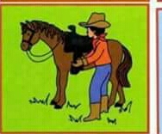
Slp:rahma

Slide 10
Slp:rahma

Slide 11
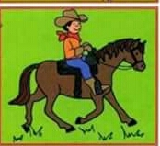
Slp:rahma

Slide 12
Slp:rahma

Slide 13
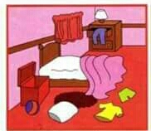
Slp:rahma

Slide 14
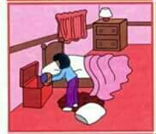
Slp:rahma

Slide 15
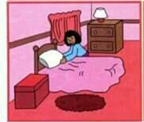
Slp:rahma

Slide 16
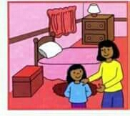
Slp:rahma

Slide 17
Slp:rahma

Slide 18
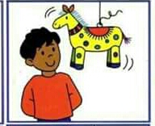
Slp:rahma

Slide 19
Slp:rahma

Slide 20
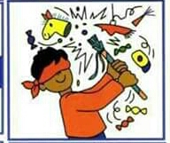
Slp:rahma

Slide 21
Slp:rahma

Slide 22
Slp:rahma

Slide 23
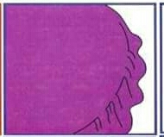
Slp:rahma

Slide 24
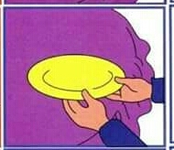
Slp:rahma

Slide 25
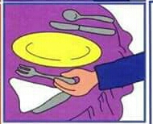
Slp:rahma

Slide 26
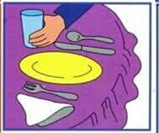
Slp:rahma

Slide 27
Slp:rahma

Slide 28
Slp:rahma

Slide 29
Slp:rahma

Slide 30
Slp:rahma

Slide 31
Slp:rahma

Slide 32
Slp:rahma

Slide 33
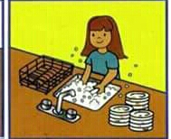
Slp:rahma

Slide 34
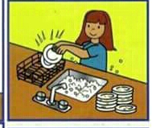
Slp:rahma

Slide 35
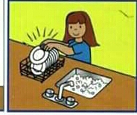
Slp:rahma

Slide 36
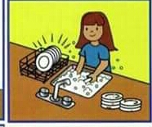
Slp:rahma

Slide 37
Slp:rahma

Slide 38
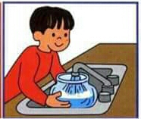
Slp:rahma

Slide 39
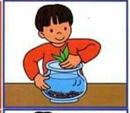
Slp:rahma

Slide 40
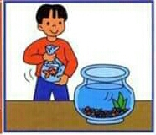
Slp:rahma

Slide 41
Slp:rahma

Slide 42
Slp:rahma

Slide 43
Slp:rahma

Slide 44
Slp:rahma

Slide 45
Slp:rahma

Slide 46
Slp:rahma

Slide 47
Slp:rahma

Slide 48
Slp:rahma

Slide 49
Slp:rahma

Slide 50
Slp:rahma

Slide 51
Slp:rahma

Slide 52
Slp:rahma

Slide 53
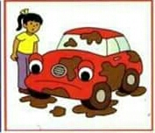
Slp:rahma

Slide 54
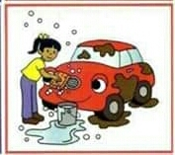
Slp:rahma

Slide 55
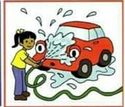
Slp:rahma

Slide 56
Slp:rahma

Slide 57
Slp:rahma

Slide 58
Slp:rahma

Slide 59
Slp:rahma

Slide 60
Slp:rahma

Slide 61
Slp:rahma

Slide 62
Slp:rahma

Slide 63
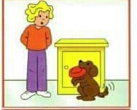
Slp:rahma

Slide 64
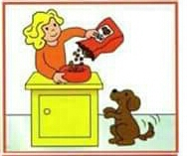
Slp:rahma

Slide 65
Slp:rahma

Slide 66
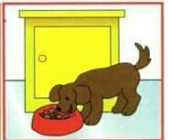
Slp:rahma

Slide 67
Slp:rahma

Slide 68
Slp:rahma

Slide 69
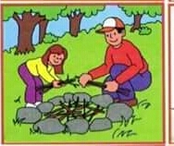
Slp:rahma

Slide 70
Slp:rahma

Slide 71
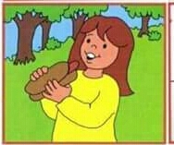
Slp:rahma

Slide 72
Slp:rahma

Slide 73
Slp:rahma

Slide 74
Slp:rahma

Slide 75
Slp:rahma

Slide 76
Slp:rahma

Slide 77
Slp:rahma

Slide 78
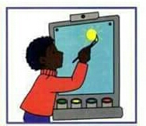
Slp:rahma

Slide 79
Slp:rahma

Slide 80
Slp:rahma

Slide 81
Slp:rahma

Slide 82
Slp:rahma

Slide 83
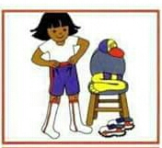
Slp:rahma

Slide 84
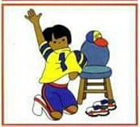
Slp:rahma

Slide 85
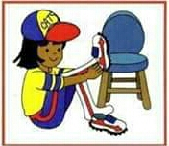
Slp:rahma

Slide 86
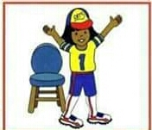
Slp:rahma

Slide 87
Slp:rahma

Slide 88
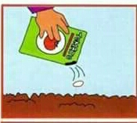
Slp:rahma

Slide 89
Slp:rahma

Slide 90
Slp:rahma

Slide 91
Slp:rahma

Slide 92
Slp:rahma

Slide 93
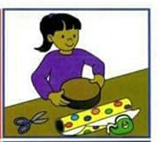
Slp:rahma

Slide 94
Slp:rahma

Slide 95
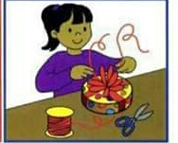
Slp:rahma

Slide 96
Slp:rahma

Slide 97
Slp:rahma

Slide 98
Slp:rahma

Slide 99
Slp:rahma

Slide 100
Slp:rahma

Slide 101
Slp:rahma

Slide 102
Slp:rahma

Slide 103
Slp:rahma

Slide 104
Slp:rahma

Slide 105
Slp:rahma

Slide 106
Slp:rahma

Slide 107
Slp:rahma

Slide 108
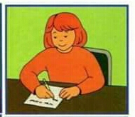
Slp:rahma

Slide 109
Slp:rahma

Slide 110
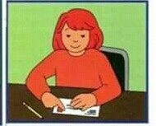
Slp:rahma

Slide 111
Slp:rahma

Slide 112
Slp:rahma

Slide 113
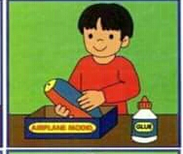
Slp:rahma

Slide 114
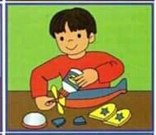
Slp:rahma

Slide 115
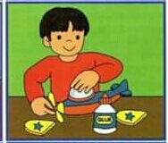
Slp:rahma

Slide 116
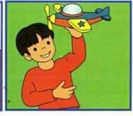
Slp:rahma

Slide 117
Slp:rahma

Slide 118
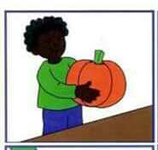
Slp:rahma

Slide 119
Slp:rahma

Slide 120
Slp:rahma

Slide 121
Slp:rahma

Slide 122
Slp:rahma

Slide 123
Slp:rahma

Slide 124
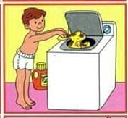
Slp:rahma

Slide 125
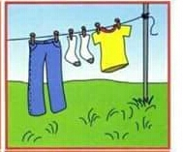
Slp:rahma

Slide 126
Slp:rahma

Slide 127
Slp:rahma

Slide 128
Slp:rahma

Slide 129
Slp:rahma

Slide 130
Slp:rahma

Slide 131
Slp:rahma

Slide 132
Slp:rahma

Slide 133
Slp:rahma

Slide 134
Slp:rahma

Slide 135
Slp:rahma

Slide 136
Slp:rahma

Slide 137
Slp:rahma

Slide 138
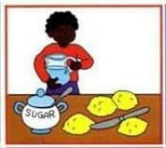
Slp:rahma

Slide 139
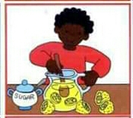
Slp:rahma

Slide 140
Slp:rahma

Slide 141
Slp:rahma

Slide 142
Slp:rahma

Slide 143
Slp:rahma

Slide 144
Slp:rahma

Slide 145
Slp:rahma

Slide 146
Slp:rahma

Slide 147
Slp:rahma

Slide 148
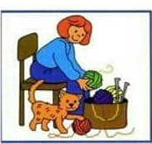
Slp:rahma

Slide 149
Slp:rahma

Slide 150
Slp:rahma

Slide 151
Slp:rahma

